Slide 1

Graph Traversal: DFS and BFS
Data Structure | Graph
Course: Data Structure | Chapter: Graph | Bachelor of Engineering
DISCOVER · LEARN · EMPOWER
Notes:
Welcome to today's lecture on Graph Traversal. We will focus specifically on Depth First Search and Breadth First Search. These are fundamental algorithms for exploring graph structures in computer science. Remember, mastering these is key to solving complex network problems.

Slide 2
Course Outcomes
SLIDE 2 / 14
Course Outcome
CO | BT LEVEL | DESCRIPTION
CO1 | BT1 | Understand and apply basic data structures, algorithms, complexity analysis, ADTs, arrays and linked lists.
CO2 | BT2 | Apply and implement stacks and queues in problem-solving.
CO3 | BT3 | Analyse and apply searching, sorting, and hashing techniques.
CO4 | BT4 | Construct and apply tree structures and traversal techniques.
CO5 | BT5 | Represent and solve graph problems using DFS, BFS, and graph algorithms.
Chandigarh University
2 / 14
Notes:
Today's lecture directly addresses two specific course outcomes. CO2 requires us to apply stacks and queues, which are the core data structures for DFS and BFS respectively. CO3 involves analyzing searching techniques, as traversal is essentially a search algorithm for graph nodes.

Slide 3
Learning Objectives
SLIDE 3 / 14
Learning Outcomes
1
Define graph traversal and its necessity in network analysis.
2
Explain the working principle of Depth First Search (DFS).
3
Explain the working principle of Breadth First Search (BFS).
4
Compare the time and space complexities of both algorithms.
5
Identify common pitfalls when implementing traversal algorithms manually.
Chandigarh University
3 / 14
Notes:
By the end of this session, you will be able to define why we traverse graphs. You will understand the distinct mechanics of DFS and BFS. We will also compare their efficiency and discuss where students often make mistakes during implementation.

Slide 4
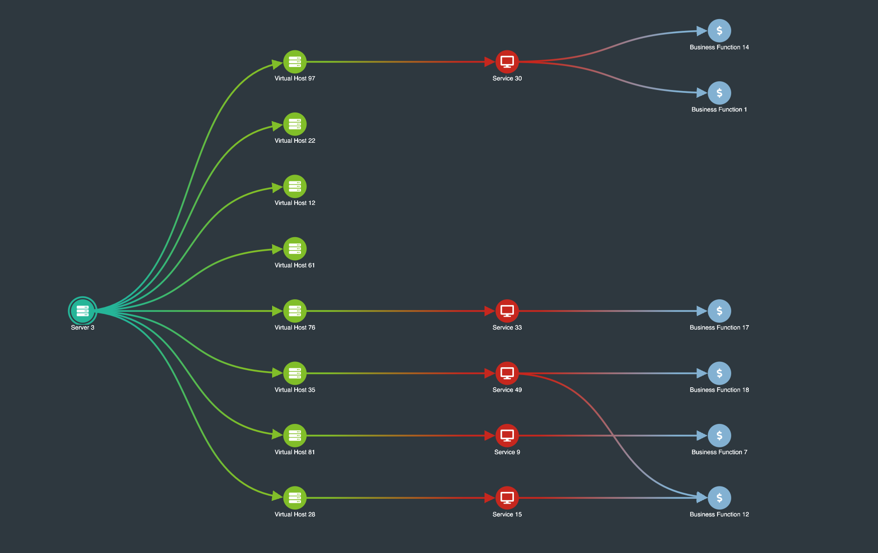
Lecture
SLIDE 4 / 14
What is Graph Traversal?
TWO PRIMARY STRATEGIES EXIST
Depth First Search and Breadth First Search.
• Graph traversal visits every node and edge in a connected graph.
• It ensures no node is missed during systematic exploration of data.
• Traversal is essential for pathfinding, cycle detection, and connectivity checks.
• The choice of strategy depends on the specific problem requirements.
• Without traversal, we cannot effectively analyze relationships in complex networks.
• Both methods require a visited array to prevent infinite loops.
Sequential Layout: The Best Way To Handle Tiered Data
Chandigarh University
4 / 14
Notes:
Think of graph traversal as exploring a maze. You must visit every room without getting stuck in a loop. This process is vital for finding paths or checking if two points are connected. We rely on two main strategies to achieve this systematically.

Slide 5
Lecture
SLIDE 5 / 14
Depth First Search (DFS) Concept
1
DFS explores as far as possible along each branch before backtracking.
2
It mimics the behavior of a person walking down a corridor.
3
The algorithm uses a Stack data structure for implementation.
4
It prioritizes depth over breadth in the exploration sequence.
5
DFS is recursive by nature but can be implemented iteratively.
6
It is ideal for tasks requiring deep path exploration or cycles.
7
The traversal order depends heavily on the adjacency list order.
Chandigarh University
5 / 14
Notes:
DFS is like exploring a cave; you go as deep as possible before turning back. Imagine walking down a long hallway and checking every side room before moving to the next hallway. This depth-first approach is implemented using a stack to remember where to return.

Slide 6
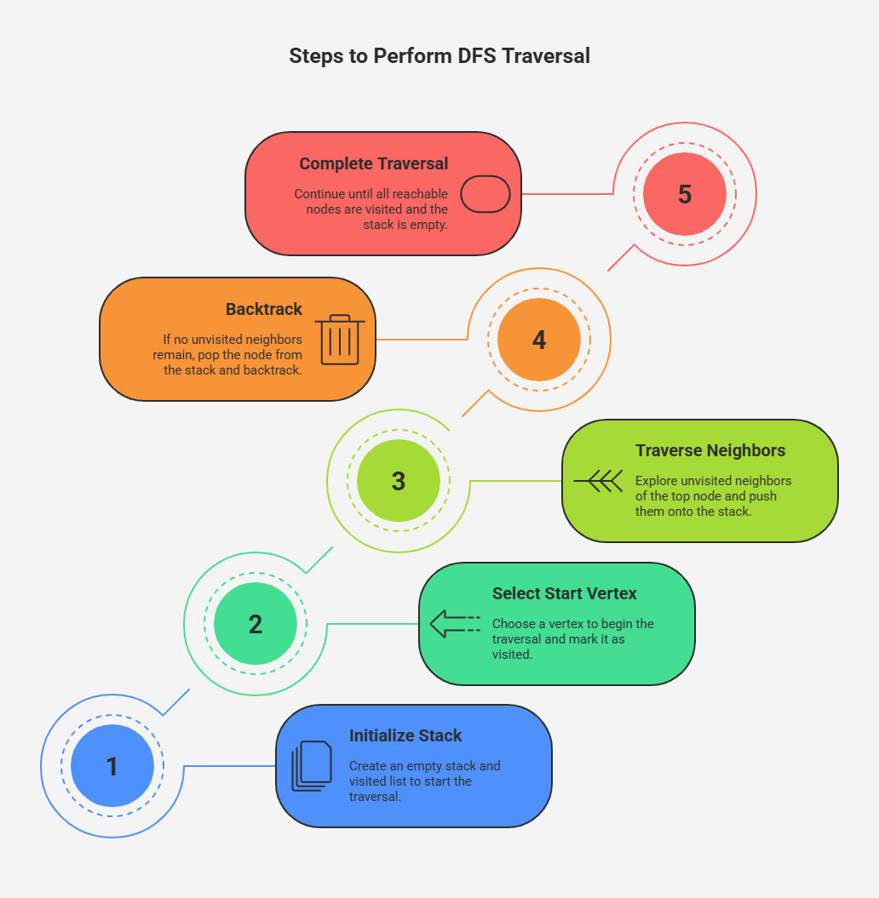
Lecture
SLIDE 6 / 14
DFS Working Principle
1
Start at a source node and mark it as visited immediately.
2
Push the current node onto the stack for backtracking later.
3
Visit an unvisited neighbor and repeat the process recursively.
4
Backtrack to the previous node when no unvisited neighbors exist.
5
Continue until the stack is empty and all nodes are visited.
6
The recursion stack implicitly handles the backtracking mechanism.
7
This ensures every connected component is fully explored systematically.
Source: ik.imagekit.io
Chandigarh University
6 / 14
Notes:
The process starts by marking the root node and pushing it onto the stack. We then move to an unvisited neighbor, repeating the process. When we hit a dead end, we pop the stack to backtrack. This continues until the stack is empty, ensuring full coverage.

Slide 7
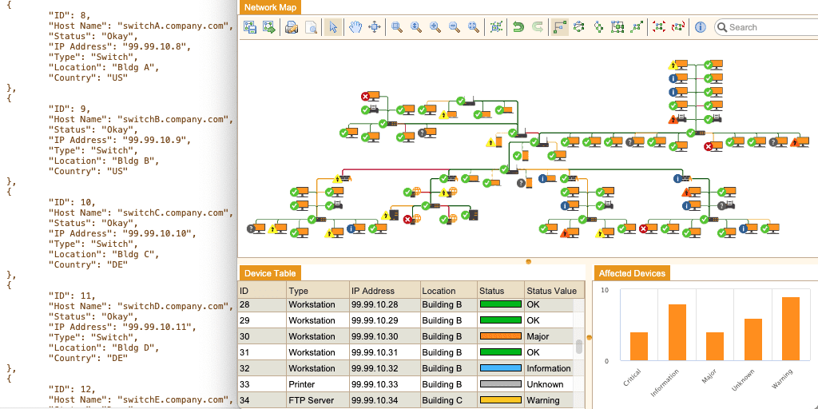
Lecture
SLIDE 7 / 14
Breadth First Search (BFS) Concept
1
BFS explores all neighbor nodes at the present depth first.
2
It expands the search radius uniformly from the source node.
3
The algorithm uses a Queue data structure for implementation.
4
It prioritizes breadth over depth in the exploration sequence.
5
BFS guarantees the shortest path in unweighted graphs.
6
It is ideal for finding the nearest neighbor or shortest path.
7
The traversal order is level-by-level across the graph.
Source: 8313502.fs1.hubspotusercontent-na1.net
Chandigarh University
7 / 14
Notes:
BFS is like dropping a stone in a pond; the ripples expand outward evenly. It explores all immediate neighbors before moving to the next level of neighbors. This level-by-level approach is implemented using a queue to manage the order of exploration.

Slide 8
Lecture
SLIDE 8 / 14
BFS Working Principle
1
Start at a source node and enqueue it into the queue.
2
Mark the source node as visited immediately upon enqueuing.
3
Dequeue a node and visit all its unvisited neighbors.
4
Enqueue all unvisited neighbors and mark them as visited.
5
Repeat the process until the queue becomes completely empty.
6
The queue ensures nodes are processed in the order discovered.
7
This guarantees that nodes are visited in increasing distance order.
Chandigarh University
8 / 14
Notes:
We start by enqueuing the source node and marking it visited. We then dequeue a node and add all its unvisited neighbors to the back of the queue. This ensures that we process nodes in the exact order they were discovered, maintaining the level-by-level order.

Slide 9
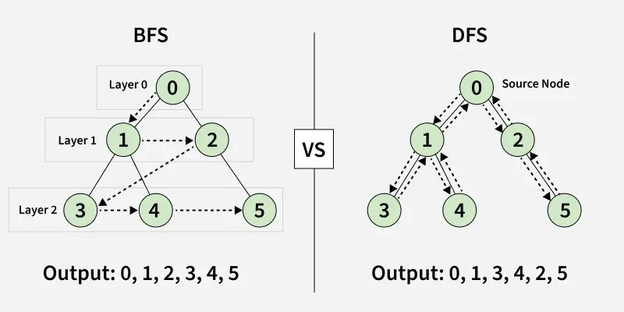
Worked Example
SLIDE 9 / 14
DFS Traversal
PATH
A → B → D (dead end) → E (dead end) → C → F.
STACK OPERATIONS
Push A, Push B, Push D, Pop D, Push E.
FINAL DFS ORDER
A, B, D, E, C, F.
• Consider a graph with nodes A, B, C, D, E, F.
• Start at node A and explore neighbors in alphabetical order.
• Backtracking occurs at D and E when no unvisited neighbors exist.
• The stack ensures we return to A to visit C after finishing B.
Source: media.geeksforgeeks.org
Chandigarh University
9 / 14
Notes:
Let's trace DFS on a simple graph starting at A. We go to B, then D. Since D has no unvisited neighbors, we backtrack to B and go to E. After E, we backtrack to A and visit C. The final order is A, B, D, E, C, F.

Slide 10
Worked Example
SLIDE 10 / 14
BFS Traversal
FINAL BFS ORDER
A, B, C, D, E, F.
• Consider the same graph with nodes A, B, C, D, E, F.
• Start at node A and enqueue it into the queue.
• Dequeue A, enqueue neighbors B and C; Queue: [B, C].
• Dequeue B, enqueue neighbors D and E; Queue: [C, D, E].
• Dequeue C, enqueue neighbor F; Queue: [D, E, F].
• The queue ensures level-by-level processing of all nodes.
Source: media.geeksforgeeks.org
Chandigarh University
10 / 14
Notes:
Now let's trace BFS on the same graph. We start at A and add B and C to the queue. Next, we process B and add D and E. Then we process C and add F. The final order is A, B, C, D, E, F, showing a level-by-level expansion.

Slide 11
Lecture
SLIDE 11 / 14
Complexity Analysis
1
Time complexity for both DFS and BFS is O(V + E).
2
V represents the number of vertices in the graph structure.
3
E represents the number of edges connecting the vertices.
4
Space complexity for DFS is O(V) due to recursion stack.
5
Space complexity for BFS is O(V) due to the queue size.
6
Both algorithms visit every node and edge exactly once.
7
Efficiency depends on the graph representation used (adjacency list).
Chandigarh University
11 / 14
Notes:
Both algorithms have a time complexity of O(V + E) because they visit every node and edge once. The space complexity is O(V) for both, but for different reasons. DFS uses the call stack for recursion, while BFS uses a queue to store nodes at the current level.

Slide 12
Lecture
SLIDE 12 / 14
Common Pitfalls in DFS
1
Failing to mark nodes as visited causes infinite recursion loops.
2
Using a global visited array without resetting for disconnected graphs.
3
Incorrect adjacency list ordering leads to non-deterministic results.
4
Stack overflow errors occur in very deep or dense graphs.
5
Confusing the order of pushing neighbors affects the traversal path.
6
Not handling disconnected components requires a loop over all nodes.
7
Ignoring edge weights can lead to incorrect shortest path assumptions.
Chandigarh University
12 / 14
Notes:
A common mistake is forgetting to mark nodes as visited, which leads to infinite loops. Another issue is not handling disconnected graphs, where a single DFS call won't visit all nodes. Always ensure you iterate through all nodes to start a new traversal if needed.

Slide 13
Lecture
SLIDE 13 / 14
Common Pitfalls in BFS
1
Enqueuing a node multiple × without checking visited status.
2
Using a stack instead of a queue breaks the level-order logic.
3
Not marking nodes as visited upon enqueuing causes duplicates.
4
Assuming BFS finds shortest paths in weighted graphs without care.
5
Queue overflow can occur in graphs with very high branching factors.
6
Incorrect initialization of the visited array leads to missed nodes.
7
Failing to handle disconnected components results in incomplete traversal.
Chandigarh University
13 / 14
Notes:
In BFS, a frequent error is enqueuing a node multiple × if you don't mark it visited immediately. You must mark it when you add it to the queue, not when you process it. Also, remember that BFS only guarantees shortest paths in unweighted graphs.

Slide 14
Lecture
SLIDE 14 / 14
References
DATA STRUCTURES
A Pseudocode Approach with C — Gilberg, Forouzan
• Data Structures — Lipschutz
• Data Structure Using C — AK Sharma
• C and Data structure — P. S. Deshpandey
Chandigarh University
14 / 14
Notes:
These four textbooks provide comprehensive coverage of graph algorithms and data structures. I recommend consulting Gilberg and Forouzan for pseudocode approaches and Lipschutz for clear explanations. Sharma and Deshpandey offer excellent C-based implementations for practical understanding.

